Slide 1
Binary Trees
Programming – Code Design & Data Structures

Slide 2
Contents
What is a Binary Tree
Why Use Binary Trees
Node Structure
Inserting and Deleting

Slide 3
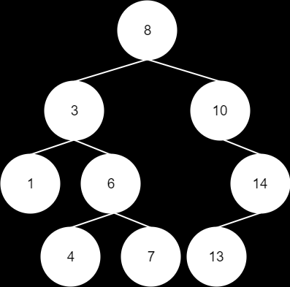
What is a Binary Tree
A tree where each nodes has a maximum of 2 children
The left sub-tree contains key values less than the root
The right sub-tree contains key values greater than the root

Slide 4
Why Use Binary Trees
The most popular variation of the Binary Tree is the Binary Search Tree
A quick and efficient search for an item in a collection
When using a list or array to store data, our worst case search time will be O(n)
If the item is the last in the list, we need to search every item!
Binary search trees use a divide-and-conquer approach
Is our search item less than the current node? Then go down the left branch. Greater than? Then go down the right branch.
For a balanced tree, gives an optimal search time of O(log n)
(that’s much, much better than O(n))

Slide 5
Node Structure
The node itself is very similar to a graph node
There is no need to store edges, we just need to store pointers to child nodes
For a binary tree we just store the two pointers
For more complex tree we might need a list or array of pointers
class TreeNode
{
private:
//this could also be a pointer
//to another object if you like
int value;
//Node's children
TreeNode* left;
TreeNode* right;
};

Slide 6
Inserting
Inserting in a Binary Tree is easy
Create a new node to store our new value
Compare the value of our new node to the root, if the new value is lower, check the left child
If higher, check the right child
Compare the new value to the child, and again if lower check left, if higher check right
Keep going until we find an empty leaf, place the new node there

Slide 7
Inserting
10
Comparison
10
Comparison
12
12
5
15
15
New Node
3
7
12
Compare to the value of the root:
- If lower, check left child.
- if greater, check right child.
NULL
The value is greater so we move to the right child and compare again.
This time the value was lower, so we move left… and run into a null pointer.
That means we’ve found a valid spot and we insert our node.
First, we create our new node

Slide 8
Deleting Nodes
Deleting nodes can be quite difficult
There are three different situations we need to deal with
Deleting a leaf
Deleting a node with one child
Deleting a node with two children

Slide 9
Deleting A Leaf
10
Deleting a leaf is easy.
If we want to remove node 12…
Then set the parent’s pointer to it to null and we’re done.
We simply delete it…
5
15
3
7
12
NULL

Slide 10
Deleting a Node with One Child
Deleting a node with one child is still pretty easy
We just need to deal with that node’s one child to make sure we don’t lose it

Slide 11
Deleting a Node with One Child
10
Lets say we want to remove node 15.
First we change its parent’s pointer to it so that it instead points to its child.
Then we just delete the node…
And we’re done.
5
12
15
3
7
12

Slide 12
Deleting a Node with Two Children
Deleting a node with two children is hard!
We not only need to keep both children, we need to reorder the tree to keep the values correct
This is difficult and inefficient so instead we cheat and do a sneaky swap

Slide 13
Deleting a Node with Two Children
We need to find the smallest value in the tree that is greater than the one we want to remove.
To do this, first we step right once so that now we are only dealing with values greater than the node we are removing.
We know all values to the left are lower so we don’t need to touch any of those.
12
10
12
Now that we are only dealing with values greater than our target node, we need to find which is the smallest.
To do this we step left as many times as we can until we run out of nodes.
In this case we find it’s node 12.
We won’t be touching any nodes that would be reached by stepping right again since those would be greater.
The next step is to copy the value of the node we found (12) over the red node we want to remove.
So now the red node’s original value has been discarded and we have two nodes with the same value.
Now we want to delete the original node 12 since its value has been relocated to the red node.
We do this using one of the two methods discussed previously:
Either it has no children and we can simply remove it, or it has one and we need to fix up some pointers.
In this case it has one child so we change its parent’s pointer so that it instead points to its child.
Then we delete it.
… and finally we’re done.
Lets say we want to remove node 10 from this tree.
This time we’re marking the target node in red to avoid later confusion.
5
15
5
5
15
15
15
copy
7
14
17
7
7
12
12
17
17
14
14

Slide 14
Summary
Binary Trees are just one simple type of tree, there are many others
Each node in a binary tree has a maximum of two children
Nodes on the left contain values less than the parent, and nodes on the right values that are greater
This makes binary trees very efficient for searching

Slide 15
References
Allen Sherrod, 2007. Data Structures and Algorithms for Game Developers (Charles River Media Game Development). 1 Edition. Course Technology PTR.

